Slide 1
Unit 4 PowerPoint
Janka Reynders

Slide 2
Syllabus Outline and Studied Texts
Voice and Perspective
Examinable content
Investigate and evaluate the relationships between texts and contexts by:
undertaking close analysis of texts
examining how each text relates to a particular context or contexts
comparing the contexts in which texts are created and received.
Evaluate different perspectives, attitudes and values represented in texts by:
analysing content, purpose and choice of language
analysing the use of voice and point of view
exploring other interpretations and aspects of context to develop a considered response.
Evaluate how texts offer perspectives through:
the selection of mode, medium, genre and type of text
the ways points of view and values are represented
the selection of language features that generate empathy or controversy.
Texts Studied
Primary Texts
The Pale Blue Dot Extract (Carl Sagan)
The Pale Blue Dot Montage (David Fu)
1984 (George Orwell)
Secondary Texts
The Ones Who Walk Away From Omelas (Ursula Le Guin)
The Handmaid’s Tale (Margret Atwood)
Brave New World (Aldous Huxley)
The Pedestrian (Ray Bradbury)
Examination Day (Henry Slesar)
An Inconvenient Truth (Al Gore)
Voice: The voice of a text is the implied author, giving readers a sense of the personality of the author or narrator
Provides readers an understanding of the attitudes and values supported or rejected within the text
Elements which contribute to the voice of a text include: diction, syntax, figurative language, tone and mode of address
Voice can be used to indicate personality, values, attitudes, perspectives or context within the text
Influences readers’ response by determining how persuasive a text is (non-fiction), or the degree to which readers sympathise with the narrator, or whether the narrator is seen as reliable (fiction)
As the controlling presence or ‘authorial voice’ of a text, the author uses voice to create an image of themselves, concurrently establishing an image of the reader
Authorial Voice: used to refer to the nature of the voice projected by the author; the persona the author adopts
Narrative Voice: Way in which the narrator may relate to the prose, adopting the role of first or third person, omnipresent or restricted in knowledge
The point of view of a text communicate the direction of interaction between author and reader, including:
Perspectives: An informed viewpoint informed by the contexts, values and beliefs of a person; categorised into four different types of perspectives
Perspective may be dynamic in nature; the role of the reader is to identify the perspective of the narrator/author, giving the reader predominate control, despite intentions of the author
Physical Perspective: Refers to the author/narrator’s physical relationship with the content of the text. Describes the physical positioning of the author/narrator within a textual situation, these establishing the physical setting of the text through the perspective of the author/narrator.
Temporal Perspective: Refers to time period in which a text is viewed, referring to the tense of the text. Tense is used as a language convention, to establish the reader’s position within the text
Example: a present tense may be used to develop a sense of immediacy in relation to the reader’s position
Psychological Perspective: Refers to the psychological and social aspects of the author’s persona, establishing their personality, experiences and socio-economic positioning. Used commonly in narrative when presenting the perspective of a narrator, involving the voice adopted by the text. Characters'’ thoughts, opinions, and viewpoints will be influence by their psychological perspectives.
Example: Tara June’s values and attitudes are constructed in Swallow the Air through the psychological perspective of her as an Indigenous child.
Example: The mental state of the author in The Yellow Wallpaper colours her viewpoints in the text
Ideological Perspective: Refers to the worldviews constructed within the text; may be characteristic of nationalities, social class, gender or occupation
Some ideologies include patriarchal, feminist, post-colonial, racial, capitalist, socialist, environmentalist
Denotes a way of thinking about a subject within the text, presented through the ideological perspective of the author/narrator; authors may naturalise particular ideologies, whilst challenging others.

Slide 3
Title: We are Here; The Pale Blue Dot
Author: Carl Sagan-1989; David Fu-2006
Genre: Hybrid Text; combines elements of Fu’s documentary still montage, narrated by Sagan’s expository text
Synopsis: Using various footage from archives and Hollywood filmography, the hybrid text We Are Here; The Pale Blue Dot, accompanies and reinforces Sagan’s extract The Pale Blue Dot; A Vision into the Future of Human in Space. The orientation of the video sets the text within the context of 1980-1990’s space exploration within the USA, panning from a mise-en-scenes of The Pale Blue Dot, thus beginning a montage of filmic clips to reinforce the auditoria of the clip.
Conventions:
Archival Footage :Fu uses graphic archival footage from Japanese WW2 POW Camps, the Vietnam War and Chinese Communism to highlight the ironic subversion of humanitarianism upon Earth. Reinforcing Sagan’s criticism of contemporary humanities as a social façade, Fu supports perspective that the horrors of current society overshadow humanitarian propagation
Visual-audio relationship: The audio-visual relationship within the film reinforces Fu’s support of Sagan’s perspectives. As such, the privileging of science within the text reinforces Sagan’s pro-scientific perspectives, seen through the visual-audio relationship. When Sagan discusses the need for science and space exploration as an extension to human possibility, the visual reinforce this perspective through depicting rockets, calculations and a superimposition between Sagan and his scientific projects
Documentary Panning: In the text, Fu pans out from the mise-en-scene of the Pale Blue Dot image, thus reinforcing Sagan’s perspective of human’s inconsequentiality within the universe. Through challenging ideas of anthropocentrism, Sagan proposes that the position of human make our position vulnerable, as our geocentric ideas manifest into an overestimation of importance. Sagan’s perspective may be challenged as a facilitator of Heideggerian angst, thereby contradicting his purpose to instil pro-action, his perspective of inconsequentiality establish mass existentialism.
Theorists:
Sartre: Being & nothingness shaped the existential phenomenology
The purpose of the ‘Human Ego’ as a unity is produced by consciousness
Pre reflective Consciousness: Involves seeing a transcendent object without personal interaction or consciousness. Eg. A house
Reflective Consciousness: Personal connections made to visual objects. Eg. My homes
Argues that consciousness assigns meaning to analysed objects; thus the meaning of self is created when purpose is found
Privileges an understanding of meaning of human existence over worldviews
Develops an ontological account of what it is to be human; an unstable co-existence of facts
In the text: The position of humans in the universe is doubted by Sagan’s perspectives, thus the idea of human meaning is questioned
Heidegger: Criticism of traditional metaphysics, supporting post-modernist perceptions
Study of being in analysing human existence in terms of temporal evolution and histories
Argued the concept of being was taken for granted, questioning the predicted manifold of meaning proposed by religion or science
Meaning and thinking transcends relative metaphysics
Highlights the concept of Being; to be is understood metaphorically, however not conceptually
Proposes that human existence is taken for granted and that we play a greater universal role, thus challenging Sagan’s perspective
Themes:
Pro-Science: Within the text Sagan privileges a pro-scientific perspective. Argues that the duty of human is to expand out into the universe, despite humanitarian issues faced at home. Sagan propagate to understand our meaning in the universe, a pro-scientific outlook must be adopted, as sciences construct the metaphysical world. To understand our position better, science and exploration expands the philosophical capabilities of humans, thus allowing us to find meaning.
Environmental Responsibility: Responsibility is an underlying theme within Sagan’s Pale Blue Dot, as it questions to which humans must prioritise to sustain our planet’s continuity. Environmentally, the text supports a holistic life-narrative, proposing that it is the human responsibility to live in balance with all biological processes, rather than take for granted our resources. Supported by both Peter Singer and Al Gore (An Inconvenient Truth), the theme of environmental responsibility is supported by Sagan’s musing that Earth is the only home will ever have, and thus we must look after where we make our stand.
Social Responsibility: Within the text, Sagan’s privileging of space exploration raises questions of social responsibility as a theme. Challenging the perspective that to progress in the future human must look to the universe, the theme of social responsibility bids humans to first address domestic challenge before transcending to cosmic exploration. Currently, humans face humanitarian issues of homelessness,, war and poverty. If we were to support Sagan’s perspective that it is our responsibility to expand, these issues are subverted, thus subverting the position of disadvantaged minorities within society. As such, the text raises the moral issue: Do we explore space, or look after home? Sagan’s perspective become hypocritical within this theme, as despite proposing a pro-scientific perspective, he also highlights the humanitarian duty of humans.
Quotes:
“It was understood by the scientists and philosophers of classical antiquity”
“An accident of geometry an optics”
“Humans are inconsequential”
“That’s here. That’s home. That’s us”
“The delusion that we have some privileged position in the universe”
“The only home we have every known…This is where we make our stand”

Slide 4
Pale Blue Dot Perspectives, Values & Attitudes
Perspectives
Postmodern perspective
In a Godless universe, the purpose of science fulfils human desires to know and learn more
Existential
Invokes an existential perspective as the idea that humans are born with no purpose is supported
Thus, it is also reinforced that humans have the ability to make their own meaning, and that our insignificance lifts a burden of cosmic expectation
Anthropocentric
The text supports an anthropocentric perspective by highlighting the detrimental influence humans have had upon the Earth’s natural environment
However, the text also rejects an anthropocentric perspective, has the idea that humans are the dominant influences upon the Earth, and thus hold some significant influence, is subverted by the overriding attitude of human inconsequentiality
Sartre
A Sartre perspective is subverted within the text, as the inconsequential nature of humans causes a disruption in the reflective consciousness of the human identity
An understanding of human meaning loses its values, as the text deems humans to be insignificant anyway
Heideggerian
Heideggerian perspective is challenged by Sagan, as the idea that human ‘Being’ is taken for granted proposes that human fail to see their significance in the universe
Geocentric
The perspective that Earth and its inhabitants are the most significant things in the universe is rejected within the text
A geocentric perspective is thus subverted, as the text supports the perspective that humans have little influence upon the universe
Humanitarian
A humanitarian perspective is predominantly supported, in that Sagan endorses the perspective that it is the duty of human to care for each other, to ensure the survival of humanity
However, opposingly, his values of pro-scientific discovery subverting humanitarian aid conversely rejects a humanitarian perspective, reflecting the bi-polar perspectives of Sagan
Environmentalist
Within the text, a holistic perspective is supported, as a support for the environment is endorsed by Sagan’s propagation that we must care for our planet
Within the text, it is inferred that humans and the biosphere must live in a holistically equal equilibrium, and that any upset to the cycle would continue the environmental degradation seen today
Attitudes
Support the attitude that Earth is nothing more than an insignificant dots in a vast cosmos
“A lonely pixel hardly distinguishable from the other points of light the Voyage would see”
“An accident of geometry and optics”
The insignificance of earth naturally normalises that the position of humanity is also unimportant upon a universal scale
“on the scarcely distinguishable inhabitants of some other corner”
The attitude that the wars humans inflict on each other are pointless, due to our insignificant position
“our obsession with nationalism is nowhere in evidence”
Reinforces the attitude that humans are inherently selfish, and that a self-inflated perception of our cosmic position has resulted in pathetic wars on trivial issues
Values
Supports values of:
Science
Sagan’s scientific background and the prominence of scientific terms highlights his value for science as an ultimate explanation to human existence
“Understood by the scientists and philosophers of classical antiquity”
Pacifism
Reinforces the destructive f war, and thus values pacifism in opposition to war
“Think of the endless cruelties visited by the inhabitants of one corner of this pixel”
Humanitarianism
Supports the value of humanitarianism are humans are obligated to deal more kindly with each other
“It underscores our responsibility to deal more kindly with one another”
Cosmic Exploration
Cosmic exploration and the advancement of humans into space is supported by Sagan’s scientific stance and by his value of space in studying astronomy
“Astronomy is a humbling and character-building experience”
Subverts values of:
Religion
Inferred criticism of religion is denoted by the slightly mocking tones in describing religions
Proposes that no external help, from God, can help humans
“Thousands of confident religions”
“There is no hint that help will come from elsewhere to save us form ourselves”

Slide 5
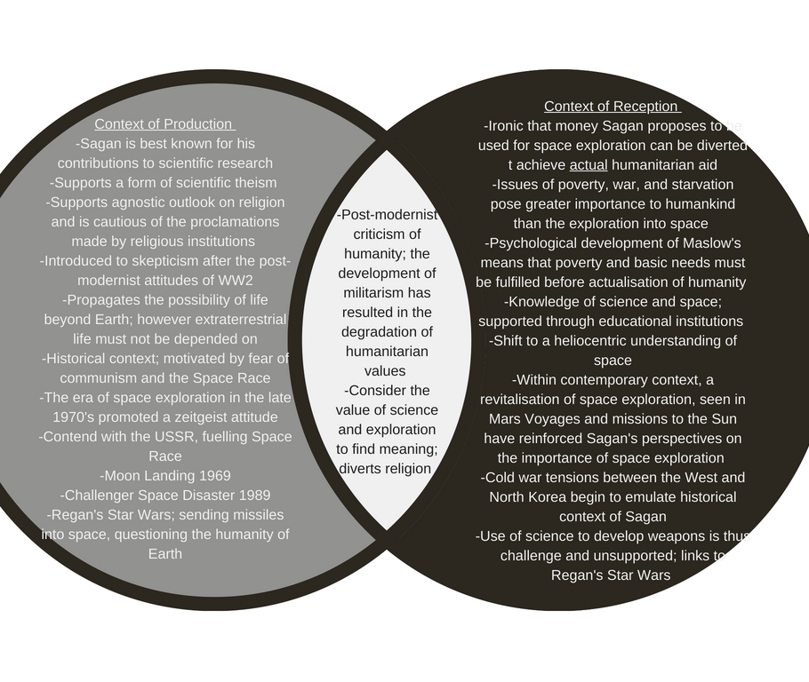
Pale Blue Dot Comparing Contexts

Slide 6
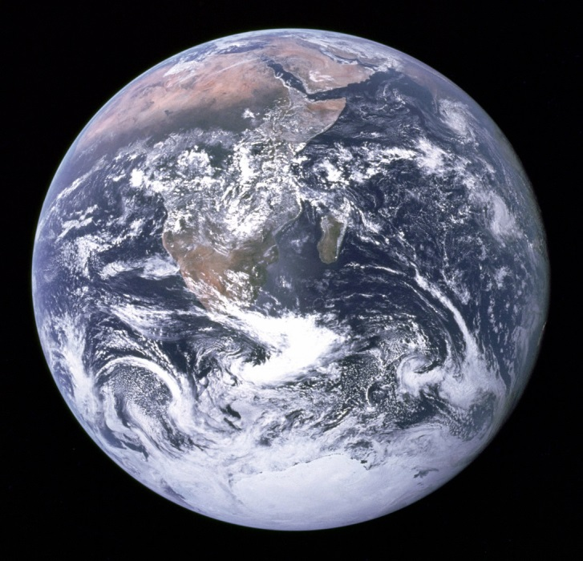

Mise En Scene: Pale Blue Dot
Film Conventions
Mimetic
Special Effects
Subtitles
Camera Work: Angles and movement
Scene editing
Montage
Body language and Gaze
Colour Hue and Tone
Contrast
Framing
Orientation
Rule of Thirds
Salience
Symbolism
Composition
Framing
Juxtaposition
Editing
Background, Mid-ground, Foreground
Colour symbolism
Shading
Non-Diegetic
Sound Effects
Soundtrack
Voiceover
Diegetic
Dialogue
Interview
Breaking fourth wall; direct address
The Blue Marble
The most common depiction of Earth, the image taken from the Apollo 17 mission
Supports a geocentric perspective of human’s position within the universe
Earth spans across the image, reinforcing the idea that humans occupy a significant role within the universe
Earth is centralized in the image, representing a centered position within the universe
Most reproduced representation of Earth, reflecting human nature in privileging our own sense of importance
Challenged by Sagan’s perspective, as the image contradicts the image of the Pale Blue Dot
Juxtapositions with the Pale Blue Dot image as Earth is the most salient subject within the image, and span to cover most of the frame
The Pale Blue Dot
Taken by the Voyage Missions in 1989, Earth is depicted to be nothing more than a blue pixel within the cosmos
Subverts the perspective of Earth’s significance; minuscule size of Earth in the image denotes its insignificance when compared to the great size of the universe
Within the image, Earth seems to be suspended in a sunbeam, inferring some sort of privileging
However, Sagan rejects this view, denouncing the lightning of Earth in a stream of light as nothing more than an accident of optics
Earth’s position is questioned, as the clear loneliness of the plant in the dark nothingness represents its detached position from all other cosmic bodes; positioned in the image on the lowest and most right line of thirds, reinforcing its subservient role
As Earth is visually isolated, the image represents the negation of purpose of Earth
It is so far away from all other cosmic bodies, the existence of Earth would have no impact; the only impact would be to human inhabitant, who are inconsequential anyway
Thus the image support’s Sagan’s perspective of human inconsequently, and rejects the viewpoint that humans have a geocentric importance in the universe.

Slide 7

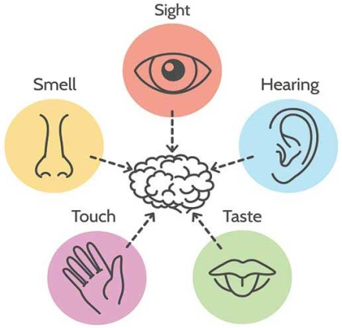
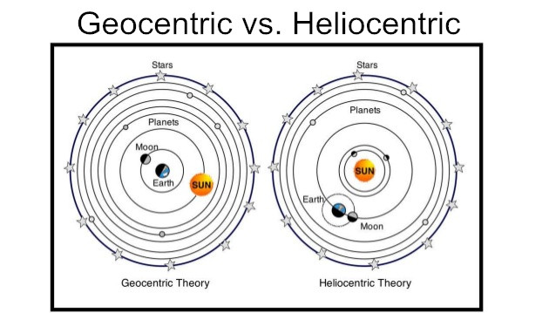
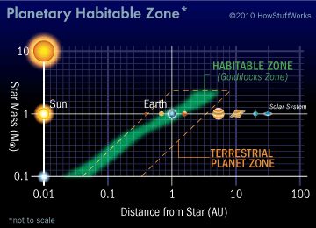
Anthropocene
The Anthropocene relates to the current geological age in which the activities of humans have been dominant influences upon society and the Earth’s environment
Previously, Earth was believed to be in a Holocene period, however environmentalist argue that humankind’s detrimental influence upon the climate denotes a new geological period of human acceleration
Empiricism
Empiricism refers to the scientific doctrine stating that all knowledge ultimately comes from a sensory and observable evidence, rather than intuition or pre-conceived ideas
Thus in The Pale Blue Dot, Sagan supports the theory of empiricism, as he proposes that space exploration offers the only method of understanding humanity’s position in the cosmos
Endorses that experimental sciences, such as exploring space, is the true facilitator of knowledge and thus should be supported in society
Knowledge can only be collected with experimental data using five sense; establish reality
Geocentrism
The Earth is the centre of the universe and the centrifugal for all cosmic activity
Belief that Earth and its inhabitants are the most significant characteristic of the universe
Replaced by Heliocentrism; belief that the universe revolved around the Sun; Under heliocentric paradigm, human uniqueness endangered
Shift from geocentrism to heliocentrism diminished the idea of human consequentiality
Maintained by religious belief that God created the Earth, and therefore we reside in a privileged position in the universe
Maslow’s Hierarchy of needs view humans as capable od achieving beyond basic needs, therefore have the capacity to transcend inconsequential positioning
The Anthropic Principle
A form of neo-geocentrism, the Anthropic Principle argue that humanity’s position serves an important role in the universe ; constrained by necessity to allow human existence
The cosmological constant; conditions of universe allow for the formation of structure large enough to support life; preconception of human existence
Biological existence influences the composition of stars through carbon nuclei, essential to life are also essential to stellar interiors; humans existence bear an existential importance to the universe
“The Anthropic Principle is essential if one is to pick out a solution to represent the universe from the zoo of solutions” Stephen Hawking
Quantum Theories of Consciousness: link to a participatory universe, as conscious resides within the processing capabilities of quarks
No universe can be real until it is observed
Therefore, the consciousness of humans interface with the consciousness of quarks, signifying human importance in the processing mechanism of quarks in the universe
The Human Ego
The Pale Blue Dot threatens Freud’s concept of the human ego
A dysfunctional ego limits the capabilities of humanity to enact change; leads to mass amotivation and existential angst
Subverting the importance of humanity threatens humanity’s ego
Diminishes a degrees of insight, agency, self-esteem, empathy, integration and purpose and philosophical development
Thereby subverts the importance of other moral needs, such as humanitarianism; renders Sagan’s warning for humanity irrelevant, as humans remain inconsequential anyway
If humans don’t matter, what is the point of trying to change anything?
Humanitarianism
The doctrine in which humanity’s obligation is to ensure the welfare of the entirety of the human race
Claims to transcend partisan politics to maintain international aid
Unlike philanthropy, humanitarianism is human responsibility
Focuses on solution not mitigation: shift in humanitarianism should privilege the prevention of crisis; avoid hypocritical aid that subverts mitigation
Humanitarianism should focus on improving conditions as well as preventing threats such as wars

Slide 8
Title: 1984
Author: George Orwell (1949)
Genre: Speculative dystopic fiction
Synopsis: Set within the dystopic ‘future’ of 1984, the novel examines the experiences of protagonist Winston Smith, an Outer Party member living under the oppressive control of the Ingsoc totalitarian state. Characterised as an individually minded person within a society of complacency, Winston find himself ostracised, adopting a fatalistic attitude that the oppression of the Party will finally see his demise, as he fails to emulate the ‘ideal party member’. In rebellious angst, Winston begins an affair with fellow Party member Julia, whilst seeking out the existence of the rebellion group ‘The Brotherhood’ through the mysterious O’Brien. Despite hopes of inciting a revolution to overthrown the totalitarian bureaucracy, Winston is betrayed, as O'Brien reveals his allegiance to the Party as a member of the Thought Police. Undergoing psychological torture by O’Brien, Winston is ‘re-conditioned’ to accept the domination of the Party.
Conventions:
Alternative History: According to dystopic conventions, 1984 constructs a warning of the future through depiction of an alternative history. In the text the prevalence of totalitarianism is assumed to have occurred during the 1930’s, during which Britain was at war with Nazi Germany. As Winston is quoted to having not remembered a time during which his country was not at war, and considering the context of production, Orwell’s uses the novel as a warning of the dangers of totalitarianism. Motivated by Nazi domination plans and rising fears of communism, Orwell imagine a society based upon the totalitarian regime of Stalin, constructing Oceanic as a hyperbolic depiction of the Soviet Union’s autocratic society.
Social Collapse: The collapse of society is characteristic within dystopic novels, and as such, the depiction of 1984 as an oppressive police state represents a definitive decay of morality. The collapse of society is reinforced by the depilation of buildings and structures within the novel. The intermittent blasting of rocket bombs and the dehumanisation of mutilation within Oceanic society, symbolically represents the decay of morality The degraded setting thereby reinforces the idea of constant warfare, as contemporary connotations of a collapsed society is consistent with anarchical landscapes of violence and oppressive.
Free indirect Discourse: The language convention of free-indirect discourse is used to construct the style of third-person narration, whilst maintaining an essence of first-person point of view. Thus, Winston’s viewpoints are developed within a restricted physical perspective, which serve to emphasise the disempowerment of Winston under Party oppressive. Chronicling both Winston external and internal experiences, free-indirect discourse gives the reader a sense of the human complexity of Winston’s characterise, making it much easier to sympathise with him. Thus, the attitude and values of Winston used to shape audience responds, as they sympathise and support Winston, whilst rejecting the values of Oceanic society.
Theorists:
Bentham’s Panopticon: The Panopticon is literary a building in which a central watchman is able to scrutinise the actions of prisoners without the prisoners knowing at any given time whether or not they are being watched
Metaphorically however, the Panopticon traces the oppressive nature of totalitarian surveillance over society
The Panopticon can be depicted either as a socially positive implication, ensuring that social cohesion is maintained, or it can be constructed as the oppressive surveillance state oppressing individuality
Within 1984, Orwell portrays the constant state of surveillance as a gross breach of privacy, degrading the social opportunity for private life, as the Party’s control becomes omnipresent
Milgram’s Obedience Experiment: In 1961, The Milgram Obedience Experiment was carried out at Yale University, in which participants were forced to obey the instructions of examiners, despite causing pain to others
The experiment found that 65% of participants obeyed examiners in delivering a hypothetically deadly 450 watt shock
Focusing on the psychological conflict between personal conscience and authoritarian obedience, the experiment was influenced by the trial of Eichmann, who claimed to be wholly obedient t the Nazi regime
The experiment reflect how the manipulation of totalitarianism can manifest into the subversion of morality, as seen by the Parsons children who are wholly dedicated to the Party.
Descartes: The philosophy that everything human interpret is a result of pre-conceived beliefs influencing our senses
Propagates that nothing is really ‘known’ as everything is predetermined and therefore corrupted by social constructions
Argues that the only thing that is truly ‘known’ is oneself; if one is able to question the nature of existence, then one must exist to be able to question
Indirectly referenced by Winston; “‘’I think I exist’, he said wearily. ‘I am conscious of my own identity”
Themes:
Technology: Within the text, technology is used as an important methodology of control, through which the Party manipulates and oppresses citizens into compliance. Represented by the ubiquity of telescreen , in Oceania, every moment of public and private life is scrutinised, essentially trapping citizens into bureaucratically controlled lifestyles. Scientific progression is stunted, unless it enables the Party to have greater control, as technological advance is exploited beyond initial intentions.
Language: Language in central to the behavioural control of the Party over its citizens within Oceania. Through diminishing the range of language, the Party essentially limits the capacity of individuality through degrading the meaning of words. Constructed on the belief that words make meaning, Newspeak is the linguistic oppression enforced by the party to restrict any unorthodoxy of expression. Used as an additional mechanism for mind manipulation; as language no longer has power, the Party maintains control through degradation every outlet of opposition.
Propaganda: Party control within Oceania is facilitated through the propaganda enforced throughout the novel. Orchestrated by the Ministry of Truth, the dissemination of all source of information enables the Party to choose exactly what is released to the public, regardless whether true or false. Propaganda always privileges the position of the government as justified in its position of power, as the public is consistently manipulated by propaganda techniques through 2 minute Hate, Hate Week, posters, Physical jerks and Community sports.
Quotes:
“Who controls the past… controls the future: who controls the presents controls the past” (pg. 34)
“He had won victory over himself. He loved Big Brother” (pg. 298)
“War is Peace. Freedom is Slavery. Ignorance is Strength” (pg. 4)
“Freedom is the freedom to say two plus two makes four” (pg. 81)
“There was, of course, no way of knowing whether you were being watched at any given moment” (pg. 3)

Slide 9
1984 Perspectives, Values & Attitudes
Perspectives
Totalitarianism
A totalitarian society, if not opposed, would result in the decay of morality and identity of individual citizens
Individualism
An individualistic perspective is reinforced by the sympathetic nature in which the reader is encouraged to support Winston’s fight for freedom from the Party’s oppression
Existentialism
People maintain their right to make their own meaning in life; although this perspective is subverted by the Party, it is reinforced by Winston's conflict with the State to achieve individual meaning
Technological Criticism
The perspective that technology degrades values of privacy and individuality is supported by the ubiquitous nature of telescreen, as well as the inability of citizens to separate private and public life
Pacificism
War is represented as a method of manipulation, thus reinforcing the perspective that the hypocrisy surrounding war is unfounded, as it is a exploitative tool use to subdue the masses
Complacency
The complacent conformity by the majority within society, represented within the novel reinforces the perspective that a complacent society would cultivate the opportunity of autocratic totalitarianism
Role of Reader
The speculative and warning nature of the text promotes a greater expectation of the reader, supporting the perspective that future generations have a duty to prevent the rise of totalitarianism, thus using the novel as a warning
Language
Within the text, the construction of language reinforces the perspective that language is the master tool of manipulation; limiting tools of expression limits the possibility of democratic protest s
Values
Supports values of:
Aesthetic Appreciation
In contrast to the ugliness which surrounds him, Winston seek the beauty of the past
Begins his diary and fixates on the antique paperweight, as these represent the beauty of the past
Language
The rise of Newspeak represent the value of language, when used as a tool for change
Although within the text, language is exploited to oppress the population, Orwell also recognises the possibility for positive change through the values of the Appendix
“Newspeak was designed to diminish the range of thought” (pg. 300)
Privacy
Privacy is valued by Winston within the text, thus it is privileged throughout the text
A degradation of privacy is criticised by Orwell within the text, thereby reinforcing the value of privacy
“You had to live… in the assumption that every second you made was overheard” (pg. 3)
Subverts values of:
Absolute power
The value of absolute power is rejected, as this value is supported by the Party, and thus rejected by the reader
Conformity
Conformity is rejected in the text, as it represents the cultivation of totalitarianism to form
Provide the conditions of oppressive to occur
Ignorance
Ignorance, albeit valued by the Party, is rejected through the depiction of the masses as ignorant to their position of oppressive
Was it possible that they could swallow that, after only 24 hours? Yes, they swallowed it” (pg. 58)
Attitudes
Within the text, Winston adopts a fatalistic attitude, accepting that his death was imminent
“You might dodge successfully for a while, even for years, but sooner or later they were bound to get you” (pg. 19)
“We are the dead” (pg. 221)
Relating to his threatened identity, Winston adopts an attitude of longing to belong to a similarly rebellious group
Seeks the Brotherhood, as this organisation would represent and validate Winston’s individualistic attitude, thus satisfying his need for belonging
“We want to join it and work for it. We are enemies of the Party” (pg. 170)
Throughout the text, a fearful attitude is constructed, as Orwell uses the experience of Winston to highlight the possibility of totalitarianism developing
Fear the rise of totalitarianism in society, largely informed by the rise of Communism within Orwell’s context of production
“It had been noticed that the tendency to use abbreviations of this kind was most marked in totalitarian countries… Comintern, Inprecorr, Agitprop” (pg. 307)
“The German Nazis and the Russian Communists came very close to us in their methods, but they never had the courage to recognize their own motives” (pg. 263)
Thus, readers are encourage to adopt a cautious tone, using the novel as a measure of governments; readers expected to be cautious towards governments emulating the characteristics of the Party, as outlined in the book
“We didn’t ought to ‘ave trusted ‘em” (pg. 33)

Slide 10
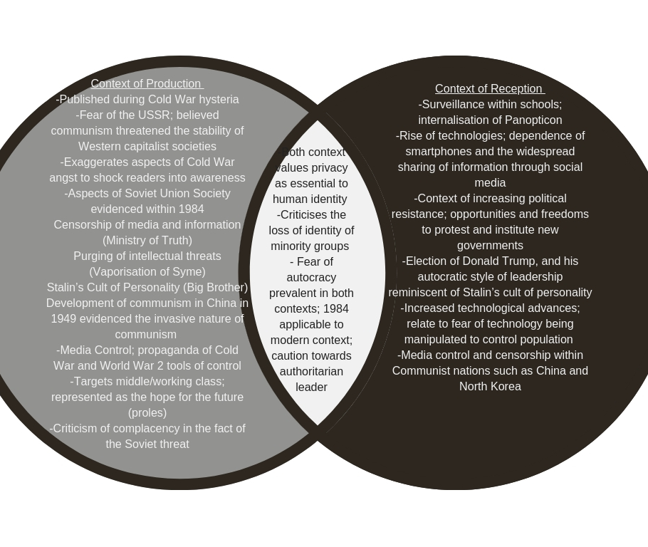
1984: Comparing Context

Slide 11



Representations
Gender Representation
Women in the text represented wither as:
“sexless automations or rebels who've defined the rule of the regime (Atwood)
The presentation of women constructed through the characterisation of Julia, Catherine and the Red-Armed prole, all of which reinforce gendered stereotypes
Julia: In the text, Julia’s value is determined by how she uses her body
Her sexuality is exploited by Winston’s as he only sees Julia as an opportunity for rebellion against the Party, not as a whole entity
Catherine: Reinforce the stereotypes that women who chose not to engage in sexual activity are boring prudes
Catherine’s orthodoxy is ridiculed, as she is represented to be empty-minded and stifling
Red armed Prole: representing the maternal stereotypes within society, the Red-armed Prole only receives positive attention when she is doing housework
Extends gender roles, that women’s value lie in their ability to produce children and care for the home
Representation of Power
Winston’s limited third person narration represents the Party’s power as seemingly infinite; Winston’s disempowered position offers a limited perspective of society
Emphasis on the trifecta; three ministries, three slogans, 3 superpower nations
Triad represented in the family (male, female, child), structure (beginning, middle, end), time (past, present and future) and in life (birth, life, death)
Concept of ‘three’ establishes continuity of power; one occurrence is insignificant, two occurrences is a coincidence, but three occurrences represents certainty
Also reinforced by religious connotations in society; The Father, the Son and the Holy Ghost
Increases the power of propaganda, making the Party more powerful and omnipresent
Power of the Party verges on supernatural, as the degree of surveillance and control, transcends all modern applications of technology
Flashpoints: Artificial intelligence developed which may be used to ‘read’ people’s emotions and biological processes to determine their feelings
The proles represent the possibility of power being shifted to privilege the people
Represents the power and voice of people
Relationships
Winston and Julia
Within Oceania, human desire is repressed, as love and loyalty to another person has the possibility to infiltrate and threaten citizen dedication to the Party
Thus the relationship between Winston and Julia is deemed illegal
“Their embrace had been a battle, the climax a victory” (pg. 126)
Alternatively, assumption that Julia and Winston’s relationship is a depiction of love is challenged
Both Winston and Julia held contradictorily motivations to beginning a relationship
Julia: Focuses on the personal, physical satisfaction of engaging in sexual activity
Winston: Use his illegal relationship with Julia as a method of rebellion against the Party
“You’re only a rebel from the waist down” (pg. 156)
Winston lacks an intelligent companionship with Julia; craves an intellectual relationship to rebel against the Party with
The maintenance of the relationship intensifies the betrayal at the conclusion of the novel
Winston’s initial hateful response towards Julia foreshadows a doomed relationship
Winston and O'Brien
From the beginning of the novel, Winston feels a strange sense of familiarity with O'Brien
Through a queer analysis of the text, Winston and O'Brien are romantically attracted to each other
To Winston, O’Brien represents an intelligent companion alongside with he can rebel against the Party
Believes O’Brien to be a part of the Brotherhood; seeks a sense of belonging with O’Brien and the Brotherhood; ‘Brotherhood’ has connotation of a male-orientated organisation, supports a queer reading of the text
“How intelligent, he thought, how intelligent!” (pg. 229)
To O’Brien, Winston represents a lost citizen member, who needs O’Brien to correct his behaviour
O’Brien believes he can cure Winston, and make him love the Party
“Don’t worry Winston; you are in my keeping. For seven years I have watched over you… I shall save you, I shall make you perfect” (pg. 244)

Slide 12
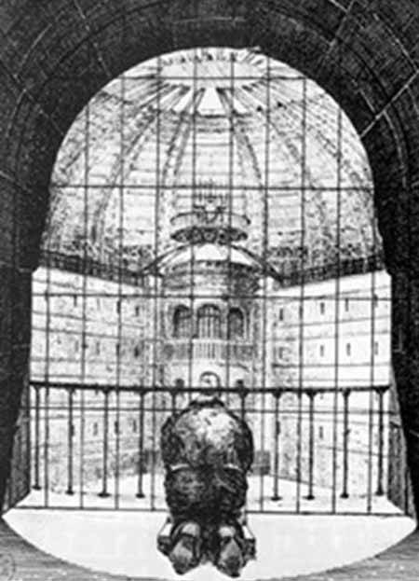
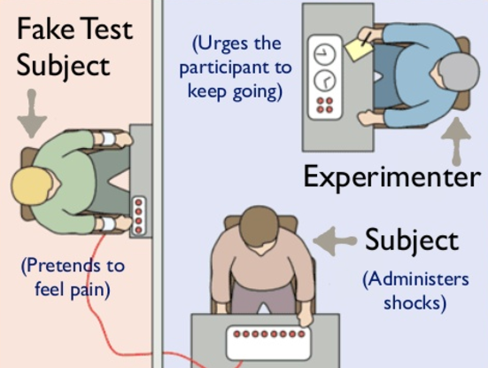
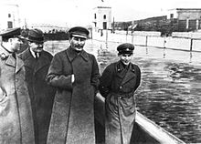
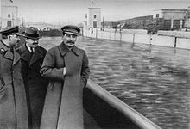
Panopticism
Based upon Bentham’s Panopticon, panopticism refers to the theories of Foucault is regards to using observation as a form of control
Believed that knowledge was the ultimate form of power; knowledge could be gained through the production, not prevention of power
Through observation new knowledge is produced
The importance of power lay in its consequences, not power itself
Proposed that instead of using violence in correction facilities, the Panopticon could be implemented
Used in prisons, asylums, schools, hospitals and the workplace
Internalised coercion of constant develops the self-policing of citizens, resulting in more sociable behaviours
One is more likely to behave socially acceptable if one felt one was being watched
Results in a sense of repression, creating internal conflict between desire and duty
Repression of individuality and the distinction between ‘private’ and ‘public’
Panopticism explores:
The relationship between systems of control and disempower peoples
The power-knowledge relationship ; proposed that power manipulation becomes more effective through mechanisms of observation
However, the unequal distribution of power occurs when particular groups control and limit knowledge, thus retaining power, leading to the possibility of oppression
Historicism
Refers to the ideological idea that to understand a historical event, one must understand the philosophical context that it took place in
Relates to an understanding of context
Refers to both the context of production, as well as the context of reception
The context of production looks at the socio-political climate which motivated the author’s construction of the text
The author utilises historical events as inspiration for the convention, themes or the message of the text
Expressed either in allegory or symbolism throughout the text
The context of reception may refer to the initial reception, as well as the contemporary reception
Initially, the context of the reception refers to the social climate when the text was first produced
The text may be rejected or accepted according to the ideas or themes of the text
A contemporary context of reception refers to how the text is received within a current context
Readers’ response in a contemporary context may be informed by current evets speculative or inferred to by the text content
Dystopic text are typically received within a contemporary context as speculative text which warn readers of the limits of humanity and reason
Historical negationism
The illegitimate denial or distortion of history, resulting in an overt manipulation of history
May refer to a physical distortion of information, or a conception devaluation of ideas
Physically practised within Stalinist Soviet Union
Stalin’s regime physically manipulated photographs and documents to eradicate people from history
An example was the erasing of Commissar Nickolai Yezhov, seen below
The Soviet Union also changed student textbooks to distort the Soviet Union perception of history; used to reinforce Stalin’s cult of personality
The rise of ‘alternative facts’ and ‘fake news’ within the Trump administration is an example of current distortions of information
Accurate facts and statistic which criticise Trump are devalued as ‘fake’
Devalues information be subverting the importance of protest against Trump
Facts are intentionally withdrawn in order to manipulate future perceptions of history
Used in propaganda to privilege particular regimes, thus reducing any evidence of protest against totalitarianism
Historical example: Chinese censorship of Tiananmen Square
All information relating to the 1989 protests are omitted in China; used to reinforce control of the Chinese People’s Party dictatorship
Milgram Obedience Experiment
Focusing on the psychological conflict between personal conscience and authoritarian obedience
Carried out 1961 at Yale University; examined the justification defence of Nazi genocide and war crime
Infamous trials such as Eichmann in Jerusalem trial motivated an examination of the degree of obedience
The experiment analysed how ordinary people responded to instruction, even if these conflict with moral obligations
Results highlighted that 65% of participant would administer a ‘fatal 450 volt shock’ when instructed to
Highlighted human capacity for cruelty, ignoring morals to remain accepted
The social conditioning of obedience to superiority cultivate a culture of conformity ad complacency
Psychological conditioning
Focuses on the psychological conditioning of population in order to influence actions
Conditioned behaviours taught to what is acceptable in society
Trance logic
The hypnotisation of subjects to attempt to create a rational explanation for irrational perceptions (Zimbardo)
Hallucination are created by the mind, knowing their falsehood, but simultaneously believing these hallucinations are real
Mind creates a circumstance that is logically more explainable when faced with circumstances than transcend logic
The conditioning of society evidently leads to a consistent state of confusion and disorientation; limits any ability of protest or rebellion
Controlling and conditioning the use of language strips any outlet of independent thought; result in an easier conditions of conformity

Slide 13
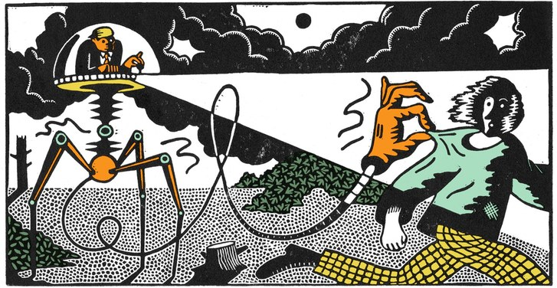


Dystopic Conventions
Dystopia: futurist or speculative society in which oppressive control is maintained through technological and bureaucratic control
Typically used to criticise the context of production, serving as a warning to future generations
Borrows feature from reality and discourses to discuss worst case implications
A subgenre of science fiction; borrows a variety of similar themes
Propaganda
Used to control citizens, as information, independent thought and freedom is restricted
Cult of Personality
Citizens worship a figurehead or religion
Used to enforced conformity and keep society pre-occupied to organise dissent
Betrayal
Society's values are betrayed, usually by the protagonist
However, this is positively received, as society’s values are rejected by readers
Social Stratification
Mirrors socio-economic division, the stratification of society serves as warning to contemporary societal division
War/Disaster
Catalyst for state of society; focus upon survival in oppression and rebellion
Used to justify oppression within society
Surveillance
Under constant surveillance, living in fear of outside world, or being ostracised
Surveillance becomes internalised, leading to conflict of self
Use secret police to instil and monitor society
Control of Society
Citizens are expected to conform; live in a dehumanised state
Portrays an illusion of utopia
Emphasis on individual powerlessness
Protagonist questions society and tries to change system; Represents hope in society
Nature
The natural world is disturbed and subverted
Setting typically in urban centres
The decay of natural environment represents the decay of socio-political structure
Family
The family unit is typically eradicated or the function of family is altered; loyalty to society
Types of Dystopian control
Corporate Control
One or more corporations control society through products, the media and advertising
Similar to governmental control; controlling force privately owned
Supports capitalistic society; motivated by commercial profits
Opportune commodification and stream-lining of society
Bureaucratic Control
Controlled by mindless bureaucracy through red tape and regulations
Link to literary work of Franz Kafka (Kafkaesque)
Technological Control
Technology just as computers, robots and science is used to exert social control
Technology advanced beyond modern capabilities
Automation of employment results in increased unemployment; sets social climate for conflict
Philosophical Control
Religious or philosophical ideology is enforced through theocratic government
Population fears that particular actions are sinful and ill result in social expulsion
Heavy privileging of particular ideals
Literary Dystopias
Orwellian: George Orwell 1984
Autocratic totalitarian control
Limitation of choice; repression of speech and minorities
Belief in order, routine and rationalism above all
Repression of dissent through fear and violence
Repression of erotic physicality through control of impulses
Explicit policing of language; control thought
Huxleyan: Aldous Huxley Brave New World
Democratic totalitarian control
Excess of choice; limited access to speech platforms and assimilation of minorities
Belief in emotionalism, control by desire, narcotics and implicit threats
Erotic physicality supressed through promotion
Implicit control of language; control thought
Kafkaesque: Franz Kafka The Metamorphosis
Rule by bureaucracy
Force free time on bureaucratic tasks which aim to induce paranoia
Self-regulation of consciousness engineered by bureaucratic surveillance; Panopticon
Control fear of life through paperwork
Phildickian: Philip Dick The Minority Report
Rule by replacing realty with an ersatz version
Foster private (reader-text) relationship
Ends with virtuality and conversion of social spaces into online forums
Stimulation of emotions; offers God-like power
Manufacturing of artificial universe

Slide 14
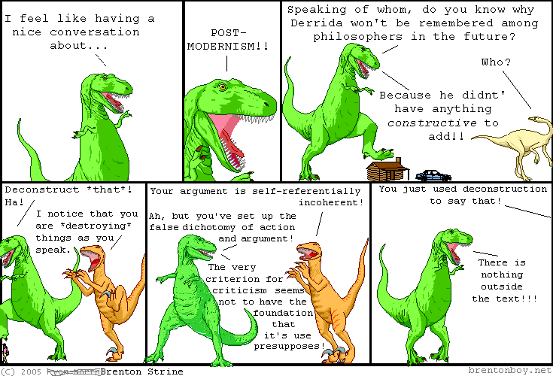
Descartes
Used to answer the philosophical questioning of the existence of everything
How do I know life is not some elaborate dream?
Through a methodological scepticism, Descartes erased all he knew from personal knowledge
Relied on reason as the best guide for beliefs and action
Adopted a rationalist perspective of society
Found that everything humans interpret or perceive are a result of pre-conceived beliefs influencing our senses
Argues that nothing is able to be truly ‘known’, hence it is impossible to really know anything
Everything society believes is thus pre-determined by levels of different belief systems
The only knowledge one can be certain of is the oneself existed
As you are able t question the nature of your own existence, there must therefore exist an entity to do the questioning
Proposed that sense were entirely unreliable; however as one is about to think, one must exist ergo, I think therefore I am
Kant’s Categorical Imperative
An imperative is an action which every person is morally or physically obligated to; may be categorical if it is true at all times and in every situation
Act only according to the maxim by which you can at the same time will that it should become a universal law
Kant suggested that moral choices are determined by a categorical imperative as the voice of our rational self; the rule of own intelligence
Categorical Imperative
Something person must do under any circumstance
Imperative to an ethical person that the choices they make are based upon the categorical imperative
Universal Law: The belief that humans should treat others how they wish to be treated in return
The value of maxims are used to apply the categorical imperative
Thus, humans live ethical lives when we use maxims to make moral decisions
Religion provided for an widespread need for ethical behaviour; however this ethical behaviours should be based upon human knowledge and reason, rather than the worship of deities
Testing the morality of an action by imagining situation in which an action was universally practised, and ‘you’ were the victim
Kant’s Categorical Imperative considers the intentions of moral actions rather than the consequences
Designed to shift the perspective by which we judge action, thus highlighting possible limitations with our ethical choices
Discusses the idea of liberty not as an opportunity to do whatever we want, and that humans may become enslaved by their own or other’s desires
A free will and a will under moral laws are one and the same
Foucault discourse
The circulation of power throughout society remains hierarchical in nature
An examination of regimes of power is revealed through a deconstruction of history
Examine how and why particular patterns of thinking are accepted as truths whilst others are marginalised
Analysis and understand basis of power; applying history to contextual issues
Knowledge forms the basis of power; thus knowledge can be gained from producing power not preventing it
Madness in Civilisation
Challenges accepted idea that the mentally ill are better treat in a contemporary context than in history
Argues in history, the ‘mad’ were see to posses a kind of wisdom as they represented the limits of reason
Now the ‘mad’ are socially isolation and dehumanised
The Medical Gaze” The dehumanisation of patients, as doctors view patients as a set of dysfunctional organs, and not a personal entity
Discipline and Punishment
Challenged the normalised view that prison systems are more humane
Power is mascaraed to be kind and fair in modern society
Challenged by the rise of movements such as ‘Black Lives Matter’
Police Violence
In the past, discipline was openly unkind and therefore could be protested in society
The covert nature of power disallows for public opportunity to protest against social inequalities
Diminishes the voice of people and subverts social checks and balances of judicial power
Modern prison privatises the justice system, as the people can no longer resist state power and subversion of the right to protest
Derrida Discourse
Language privileged over pictures as communication leads to a greater understanding of reality
Developed the idea of deconstruction, especially within language, through which dismantling the excessive loyalty to traditionally privileged ideas
Idea that every aspect of an idea should be considered and that the privileging of certain ideas over others, narrows the capacity of balanced thought
Deconstruction
Dismantling excessive loyalty to particular idea; see aspects of truth buried in opposite
Argued that almost all thinking is riddled with the tendency to privilege one thought or idea over another; Failing to see merit in the ‘lesser’ concepts
Neglected counterparts are worthy of attention
Deconstructed binary opposed concepts
reason vs. passion
masculinity vs. femineity
profit vs. generosity
high culture vs. low culture
Understand that both concepts fundamentally flawed and thus needed each other
Deconstructing Equality: Maxim that ‘Equality is better over inequality’ isn’t inherently correct; some best human situations are examples of inequality
Education
Popular culture and sport
Family
Humans are destined to live without clear answers as every idea has an opposite and equally important counter

Slide 15
Title: The Ones Who Walk Away from Omelas
Author: Ursula Le Guin (1973)
Genre: Dystopic fiction
Synopsis: Recounting the summer festivities of the ‘utopian’ city, Omelas, despite its idealistic exterior, reveals to hide a grotesque secret, upon which the joy of the city is based. The survival of happiness is based upon the total misery of an abused child, hidden beneath the city. Despite the public awareness of the child, the people of Omelas remain guiltily complacent within their joy, valuing mass happiness over the misery of one. However, some in the city, gripped by overwhelming guilt that their happiness is based upon innocent suffering, leave Omelas rejecting the cost of joy within the city.
Theorists:
Utilitarianism: the philosophical theory in which the maximisation of welfare for the social majority is privileged over the welfare of individuals
Developed by Bentham, the theory assumes that the most morally ethic policy is the one will which result in the greatest proportion of happiness within society
Constructed within the text, as Omelas values the happiness of the majority over the well being of one abused child
Eudaimonism: a philosophical system of ethics that evaluates actions in terms of their capacity to produce happiness
Within the theory of eudaimonism, the actions of the Omelas citizens are deemed acceptable, as despite the unhappiness of the child, the majority of the population is kept happy
Thus, through produce a net profit of happiness, the ‘right’ action is to maintain the overall happiness of the city
Kant’s Categorical Imperative: Immanuel Kant’s Categorical Imperative discusses the ultimate universal law of ethic, by which all human should follow the maxim ‘Gold Rule’; treat others how you wish to be treated
The ethically right action according to the categorical imperative fulfils our ethic duty of the universal law to treat other how we wish to be treated
As no one in Omelas helps the child, the categorical imperative would argue that all citizens, including those who walk away are philosophically unethical.
Conventions:
Symbolism of The Child: Within the text, Le Guin uses the symbolism of the child as a political allegory to criticise the hierarchal structuring of society within America. As such, Le Guin judges Western society as morally guilty in subverting the happiness of lower classes for the maintenance of dominant complacency. Political structures such as capitalism are represented to be hypocritical in nature, as despite allegation of happiness as unattainable, still pursue true contentment at the cost of the suffering lower class.
Setting of Omelas: The setting of Omelas symbolises the tendency of dystopian society to mascaraed as utopias to its citizens. Initially described as the city of joy, without suffering and unhappiness, the reader immediately associates the city of Omelas with the concept of utopia. However, once the true moral decay of the city is revealed, readers realises that the utopic façade hide the dystopic and immoral nature of society. As such, the story serve to warn readers of the dynamic nature between utopia and dystopia, highlighting the manipulative nature through which dystopias may hide.
Narration Point of View: The dynamic narrator style of the text enables the reader to be integrated into the story, forcing readers to take a moral stance to the content of the story. The narrator takes a detached voice, seemingly narrating the story from the imagination, or ‘making it up’ as the story progresses. This includes the reader in the crucial meaning making of the text, and thus forces readers to adopt a moral stance to the content within the story. Readers, seemingly more involved, feel compelled to respond to the text by support or rejecting Omelas.
Themes:
Morality: Within The Ones Who Walk Away From Omelas, Le Guin criticises the morality of American society which accepts their own happiness, despite the costs of this happiness to the subverted minorities of society. The prose addresses the morality underlying hierarchal political systems, criticising the oppression of the lower castes, as the complacency of the majority is an exploitation of minorities. Thus, Le Guin questions the morality of mass complacency within their position of comfort, and as such explores the moral accountability of citizens within society, through which are forced to make a moral decision; do they accept the immorality of society like the citizens of Omelas, or reject these injustices out of shear moral indignation?
Happiness: Throughout the short story, Le Guin questions the meaning and cost of happiness within a contemporary context. Within the orientation of the prose, Le Guin explains why modern society is unable to accept happiness; society’s obsession with sophistication has degraded the simplicity of happiness, as we view those who are happy as being of lesser intellectual standing. Relating to the popularised phrase ‘Ignorance is bliss’, the subversion of happiness is due to the association between the acceptance of complacency and intellectual stagnation.
Guilt and Innocence: Themes of guilt and innocence is predominant within the text, as le Guin examines who is guilty and who is innocent, and how these roles affect members of Omelas. In the text, some citizens learn to accept the guilt of knowing their happiness is dependant on unimaginable suffering, whilst other who cannot accept the guilt are the ones to walk away. Ultimately, both these groups are morally guilty, as neither make any moral action to change the degradation of rights seen in Omelas. Therefore, readers may judge that the only ‘innocent’ f the city, is the child itself, who through no personal crimes, find itself in misery. However, as the only morally innocent citizens is the one who is punished, this raise moral questions about the values of Omelas society.
Context:
Eichmann in Jerusalem Trial
Adolf Eichmann was a Nazi SS-Lieutant Colonel, and one of the major orchestrators of the Holocaust atrocities in accordance to Hitler’s Final Solution Scheme
During his trial in Jerusalem for the crime committed against the Jew populations within Europe, he claimed to be merely obeying the order from superiors
Unable to think for himself, Eichmann would regurgitate clichés in the trial, showcasing a following personality
Eichmann was sentenced to execution; despite external pressure of the Nazi totalitarianism, Eichmann had still neglected his moral duty to reject the Party’s orders
In the text, Le Guin criticises the Omelas’ failure in their moral duty to help the abused child, just as Eichmann had failed in his moral duty to the Jewish people.
Vietnam War
During the Vietnam War, due to the mass distribution of photo-journalism chronicling the suffering endured by civilians in the war
These protests within the United States was a public display of action against moral injustice, through which protestors felt a moral duty to protest immorality witnessed
Related to the prose, as the ones who walk away from Omelas are similarly protesting the injustice of society but refusing to support the abuse of the child
Quotes:
The trouble is we have a bad habit, encouraged by pedants and sophisticates, of considering happiness as something rather stupid”
“We have almost lost hold; we can no longer describe a happy man, nor make any celebration of joy”
“They feel disgust, which they had though themselves superior to”
“But they seem to know where they are going, the ones who walk away from Omelas”

Slide 16
Title: The Handmaid’s Tale
Author: Margaret Atwood (1985)
Genre: Dystopic fiction
Synopsis: The Handmaid’s Tale details the experiences of the first wave of Handmaids; women forced to become ‘walking wombs’ for the autocratic leadership of the dystopic society. Gilead as a patriarchal society enforces a series of constraint on the freedoms of women, who are quantitatively categorised according to their function in relation to centric male figure. The short extract Historical Notes serves as the epilogue of the text, and thus presents a detached discussion of Gilead’s totalitarian society.
Theorists:
Biological Essentialism
Biological essentialism refers to the theory that all components of the human body must be used for their intended biological purpose
Thus the theory argues, that for women to be accept as legitimate in society, they must bear children, as this is their biological purpose.
The theory is used to validate the oppression seen within the text, and thus subverts the social freedoms of women to chose whether or not to bear children
Madonna-Whore Complex
The Madonna-Whore Complex categorises women into two absolute identities
The Madonna, refers to the perceptive of the Virgin Mary, relating sexless women to the idealised ideas of purity, motherhood and chastity
The Whore, refers to any women who is deemed sexually desirable, as she is seen to the be the corruption of society
The Complex has innate relevance to current society, as women are judged as either ‘sluts’ or ‘prude’ when they fail to conform to social expectations of sexuality.
Judith Butler
Butler criticised society for trying to categorise women into discrete, ahistorical groups with stereotypical characteristic
She argues that identity is a fluid concept largely influence by Freud’s notions that identity is developed upon a normalisation within society
She propagates however, that this normal standard is unable to categorise any women; identity s thus a dynamic concept influenced by personal values and attitudes rather than the pre-conceived expectations of society.
Conventions:
Point of View: Point of view is used within the text to reinforce the oppressive control within totalitarian society, through both a detached and integrated narrative point of view. The majority of the text is written in first person point of view, from the perspective of a Handmaid, describing the intimate oppression enforced by Gileadean society. The Historical Notes, however is written from a point of view detached from the predominant storyline, offering an outsider perspective in the degradation of civil rights witnessed in the text. Hence, the juxtaposition between point of view reinforces the oppressive nature of society.
Colour Symbolism: Colour is used within the text to symbolically represent the categorisation of women within society. The colour symbolism of women’s uniform represent their relative function to men. The Handmaids most strikingly wear red, a colour typically associated with sex, passion and immorality. The Wives wear blue, representing the purity associated with Madonna blue. The Marthas wear khaki green, representing that they are relatively unseen by the men of household, thus serving as cooks and cleaners. Finally, the Aunts wear brown, a typically masculine colour, representing that the Aunts must give up their femineity in order to gain a small amount of power.
Historical Context: Historical context is an important convention used to motivate the events and themes of the text, as Atwood based many of the oppressive elements upon real-life concerns within the 1980s. As quoted in an interview, Atwood stated that “these are no imaginary policies, no imaginary atrocities”, highlighting that the premise of Gilead’s most shocking aspects were in fact based upon real events. Thus, the text reinforces dystopic expectation of a warning to society; Atwood’s use of real life atrocities to demonstrates the speculative future of contemporary society.
Themes:
Religious Control: Within the text, the rise of the Sons of Jacob illustrates warnings of religious fundamentalism in gaining supreme control over society. The Handmaid’s Tale thus portrays a society completed ruled by a theocratic bureaucracy, imposing religious values upon the entirety of the population. Whilst the book doesn’t directly criticise religion as a facilitator of totalitarianism, it does warn against an overly zealous enforcement of religion.
Surveillance: Surveillance in the text mimics concepts of a panoptic society, with society being internalised into the control values of society. In Gilead, no one is trustworthy, as any member of society may be part of the secret police system; The Eye. Furthermore, the theme of surveillance is reinforced in the book, as the Handmaid’s are constantly watched in their ‘homes’, and are forced to spy on each other in public.
Identity: In the Handmaid’s Tale, the identity of women is systematically categorised into legitimate and illegitimate. The legitimate women re those accepted by society, and thus have constrained function to which they must perform for men. The illegitimate women are those outcast in society; women of the colonies and illegal Jezebels are dehumanised, as their identity within society is deemed as illegitimate due to their infertility.
Context:
Iranian Revolution:
Revolution by Islamic fundamentalists; disgusted with society, the regime overthrew the Western ideals of democracy within the nation
Severe restrictions on women; loss of rights
Denied access to employment, education, hijab clothing restrictions enforced
Overnight, women lost civil freedoms previously enjoyed
Puritanism:
Strict Principles of English Protestants enforced on society during the reign of Oliver Cromwell
Simplify and regulate worship in Britain
Censorship of moral beliefs regarding self-indulgence and sex
People given names like ‘Serena Joy’
Rise in Infertility
6% married women (approx. 1.5 million) infertile between 2006 and 2010
Low infertility associated with increasing STIs (AIDs), birth control and abortions
Fears that nuclear output has also influenced falling fertility rates
IVF deemed immoral by religious fundamentalists
Quotes:
“Our big mistake was teaching them to read. We won’t make that mistake again” (pg. )
“Replaced the serial polygamy common in the pre-Gilead period with the older form of simultaneous polygamy practises in the Old Testament” (pg. 305)
“There is more than one kind of freedom… Freedom to and freedom from” (pg. 24)
“ She doesn’t make speeches anymore. She has become speechless” (pg. 46)

Slide 17
Title: Brave New World
Author: Aldous Huxley(1932)
Genre: Dystopic fiction
Synopsis: Set in a futuristic London, 600 year after the release of Henry Ford’s death, humanity has become almost entirely industrialised, and as such, is completely controlled by few elitist in charge of the World State. Within the first chapter of the novel, Huxley describes the strict caste system controlling the genetic modification of foetuses. In a society which literally grows people, destiny and the freedom to chose ones identity is subverted, as society conditions and physically manipulates people in their standardised role in society.
Theorists:
Gratification Theory: The gratification theory refers to the commercial gratification of citizens resulting in a gradual degradation of morality
Within Brave New World, citizens re economically, physically and mentally gratified by the government, lulled into a state of complacency lacking moral ethics
Fears of gratification relate to the commercialisation of society, as companies seek to gratify all consumer needs to promote a consumeristic state
As such, freedoms and rights are subverted, as moral ethics lose their relativity within society.
Hedonism: The ethical position that pleasure is the ultimate goal and greatest good of life, and thus should be the central aim of all decisions made
Within Brave New World, pleasure is supported within society, however the hyperbolic emphasis upon pleasure degrades its value
Citizens subvert philosophical values because they are sexually and physically fulfilled, and have no reason to look between the scope of State control
The State’s power I reinforced by the complacency of citizens, who remain comfortable in their hedonistic lifestyle
Freud’s Psychosexual Development: The development of the human ego is dependant on the five stages of psychosexual development, as any unresolved issues during development may cause uncontrolled fixations and social issues.
As the sexual development of people within State society are disrupted in early childhood stages, the value of intimacy is lost in adulthood
Conventions:
De-humanisation of development: One of the most prominent conventions used within the extract is the explicit degradation of human individuality. Reflected in the setting of the text, the harvesting of foetuses and literal growing humans demeans the values of life and individuality. As each person is literally harvested and genetically modified to fit the class structure of society, Brave New World criticises the stream lining of society, constructed through the shocking degradation of live-values.
Numerical lexicon: The use of numerical date integrated within the text highlights the de-humanised nature of Brave New World’s society. Through a multitude of figures, the text highlights society’s privileging of numbers and statistics over human experiences. Thus, the identity of citizens is demeaned to a mere number. This reinforces the oppressive nature of society, questioning the values of hedonistic consumerism supported within the World State.
Neologism: In the text, neologism is used through terms such as ‘boskified’, demonstrating the foreign and frightening nature of society. Through including words of no contemporary meaning, Huxley constructs a future completely foreign, and thus warns of exactly how divergent society may be. Serving as a warning against the consumeristic and hedonistic attitudes of society, Huxley communicates that the hedonistic attitudes adopted after the first world war, and Great Depression are the worrying predecessors to a foreign and unimaginable future.
Themes:
Class: Within the text, class is criticised, as people are systematically categorised according to their genetic statute, which is controlled by the dominant Party. Thus, people are classed and treated accordingly with those of lower class (Deltas ad Epsilons) are forced to commit to suffering in the occupations dismissed by society. Those outside the typical class system are considered ‘Savage’ or unhuman, and are oppressed by the covert tyranny of the Party. Limitation of literature and knowledge to lower classes, further reinforce class oppression, seen as a theme within the novel.
Commodification: Commodification refers to the treatment of humankind as nothing more than a resource commodity. In Brave New World, the value of humanity is based upon their abilities to fulfilled expected social roles, as the provision and gratification of society leave the population complacent within their limited position. Thus, humanise are commodified allegedly, to maintain the social stability of humankind, however, as revealed by the World Controller, this oppression of the population allows to the retention f power amidst the dominant elite. With people treated as a resource rather than a human, the moral direction of society is questioned.
Genetic Modification: Genetic modification is a generic dystopian theme constructed within the text. As embryos are starved of oxygen, they are genetically modified to become lesser human beings, raising moral questions to the values of society in Brave New World. The genetic modification, reinforced later by development conditioning establishes a complacent population, and therefore warns readers of a future in which humanity remains complacent within their position of power, at the cost of subverted minorities, who remain trapped in their oppression.
Context:
Mass Production
During the 1930s, Ford’ T Model came to represent the American Dream; stream-lining and living a hedonistic life style after the horrors experienced in World War One
Became the prime example of producing standardised products to be consumed by the capitalistic market
The development of the assembly line and conveyor belt was introduced by Ford, making mass production much easier
Popularised in the 1930’s ad theoretically applied to biologic processes in Brave New World.
Eugenics
Prominent studies into genetics was used as justification within the Age of Imperialism
Term coined by Francis Galton, who applied Darwin’s theories of evolution to anthropological studies
People classed based upon their genetics and phenetics characteristics
Genetic modification only applied to plants at this stage; Mendel’s Pea Experiment
Hypothesised that artificial selection could genetically breed out particular genetic traits
Age of Imperialism
The ‘White Man’s Burden’, as Europeans believed it their Christian duty to colonise Savages
As seen in the novel, John the Savage is brought to London for selfish and power-hungry reasons; reflect the nature in which indigenous cultures were exploited by Europeans
Quotes:
“That is the secret of happiness and virtue- liking what you've got to do”
“Community, Identity, Stability. Grand words”
“Out f the realm of mere slavish imitation f nature into the much more interesting world of human invention”
“Making people like their unescapable social destiny”

Slide 18
Title: The Pedestrian
Author: Ray Bradbury (1951)
Genre: Dystopic fiction
Synopsis: Within the short story The Pedestrian, Bradbury offers a cautionary glance into 2053, where the protagonist, Leonard Med, goes for solitary walks in the evenings. Unmarried and classified as unemployed, Mr Mead is the only pedestrian living in the vast metropoles, atypical from the majority of society who spend evenings enslaved to the television. One particular evening, he is stopped by the only remaining city police car, and questioned about his life. Unsatisfied with his answers, the automated car transports Mead to a psychiatric centre, despite there being nothing wrong with him.
Theorists:
McCarthyism: Prevalent in the 1950’s during the age of Cold War intrigue, McCarthyism was a social fear of alternative activities un-authorised by the government
A manifestation of Cold War fears, McCarthyism resulted in the alienation of individuality
Public hysteria used McCarthyism to seek scape-goats embroiled with ‘Soviet Espionage’
McCarthy himself was a prominent t American politician, who’s drastic anti-communist view were largely accepted in society
Encouraged the reporting of neighbours, facilitating a society of suspicion
Conventions:
Juxtaposition of natural and concrete setting: Within The Pedestrian, the juxtaposition between the natural and concrete literally and symbolically reinforces a criticism of urbanised conformity. Within the concrete city, all individuality is subverted, as the people continue to conform to social expectations; going to work, coming home and watching television. On Mead’s walks, he notices the natural reclamation of the concrete landscape, as the natural flowers and grasses begin to overtake the concrete paths. This is symbolic of the natural individuality Mead represents, thus communicating that the natural individuality of human nature will over-take the oppressive of a stagnant society.
Symbolism of Light: The symbolism of light within the text constructs the idea of Mead’s identity within society. Through the binary opposition between Mead’s lit house, and the darkness of his neighbour, Mead’s residence symbolises his difference within society, easily identifiable and there punished for his non-conformity. Literarily, connotations of light symbolise enlightenment and knowledge, reinforcing Mead’s stance against the corruption of technology, privileging him as knowledgeable against the conformity of the government; however, this non-conformity is punished, thereby criticising the representation of society within the story.
Characterisation of Mr Mead: Within a context of production, Mr Mead is characterised as a typical 1950’s man. During this context, evening walks were a popular past time, and Mr Mead represents a typical 1950’s citizen. Thus, the short story is successful in gartering a shocked response within the context of production; the audience is lead to question the values of society, as they become aware of how normality may be subverted within the future.
Themes:
Break down of Society: The break down of society within the text is a key theme which governs the warning tone constructed by Bradbury. Describing a society in which the population remain complacently ensnared by their television sets, Bradbury argues that the complacency of society leads to the fundamental break down of morality. When Mr Mead is unfairly arrested, there is no ability for protest, thus depicting a broken dystopic society which is characteristically undemocratic, decaying in moral standing.
Criticism of Technology: Represented by the automatic police car and the ubiquitous televisions sets, technology is criticised by Bradbury within the text, as these facilitate the decay of society. The ironic personification of the police car and the entrapping nature of television reinforce this criticism, as both technological devices are representing as oppressive in nature..
Individuality: In the text, individuality is questioned, as Bradbury utilises the text as a warning of dystopic society. Within the text, individuality is subverted, demonstrated by Mr Mead’s imprisonment for participating in activities (walking) uncontrolled by the bureaucracy. Thus, the text highlights the threat to individuality, if a technologically dependant and oppressive society was allowed to develop.
Context:
Formation of the CIA
During the Cold War, the threat od Communism prompted President Truman to increase internal intelligence
Attempt to combat threat of Soviet espionage
Need for centralised intelligence agency resulted in the formation of the CIA
Purpose to provide strategic warning and conduct clandestine investigations
Lavender Scare
A result of 1950’s homophobia
The expectation of wife and heath subverted the homosexuality of citizens during the 1950’s
Homosexuality was repressed in society, as it countered many world policies to re-populate after the devastation of Word War 2
The 1950’s was one of the most conservative decades
The Lavender Scare resulted in homosexual employees fired from civil service
They were seen as ‘security risks’
HUAC
The House of Un-American Activities Committee
Set up to investigate neighbourhood activities
Investigated alleged disloyalty especially any linked to Soviet spying
Quotes:
The tombs, ill-lit by television light, where the people sat like the dead, the grey or multicoloured light touching their faces but never really touching them”
“He was alone in this world of AD 2053, or as good as alone”
“The cement was vanishing under flowers and grass”
“He had never met another person walking, not once in all that time”

Slide 19
Title: Examination Day
Author: Henry Slesar (1958)
Genre: Dystopic fiction
Synopsis: The short story Examination Day, revolves around the 12th birthday of a young boy, ‘Dick’ Jordan living within a futuristic society. One wee after his birthday celebrations, Dick completes a compulsory government examination, which measure the intelligence quotient of all twelve year old children. Unbeknownst to the reader however, the society in which Dick lives in privileges public ignorance. Thus, when Dick completes the test, his exceedingly high score results in his authorised execution.
Theorists:
Humanism: the idea that individual human experiences form the foundations of knowledge
The text highlight the threat the dystopic social systems pose to the support of humanism in society
For example, the naturally inquisitive nature of human is subverted and punished in the text, as this threatens the control of government
Conventions:
Characterisation of Dick: Within the text, Dick is characterised as an inquisitive youngster, representing the questioning nature of future generations. Historically, upcoming generation are enabled to criticise the actions of current and previous generations; during the 1920’s the Jazz Age directly rejected the staunch values of Victorian society, highlighting the ability of the future to enact society change. However, Dick’s death reinforces the idea that within this society, all ability for social change of protest is purged, as the cull f intelligence results in the limitations of generations to question the fundamentals of society.
Foreshadowing: Furthermore, the rainy weather on Dick’s birthday concurrently foreshadows the sad ending of the story, as well as representing the tension surrounding the examination within the Jordan household. Weather is thus used to foreshadow a change within the story, signalling to readers that an unexpected ending is set to invoke a shocked response. Despite being somewhat warned of the ending through foreshadowing, the ending is effective in shocking readers, who are unable to imagine a society in which intelligence is subverted, not privileged.
Juxtaposition of setting: Within the text, the juxtaposition between setting highlights the oppressive and dominant nature of government over family. In the text, the comfort of the Jordan’s home is contrasted to the clinical and impersonal nature of the Government Educational building. This represents the impersonality of the government, who remain unconcerned with the immorality of killing children. As the dismissal of the state is accepted within society, it denotes the idea that loyalty to the ‘family’ unit is subservient to loyalty to the government, despite the sad atmosphere in which Dick’s death is accepted.
Themes:
Repression of Intelligence: In Examination Day, intelligence is repressed through bureaucratic control, preventing any critical analyses of society from occurring. Thus, intelligence is limited as to construct an ignorant society, who remain complacent within their position of oppression, and live without questioning the governments position. As intelligence offers an opportunity of political opposition, through extinguishing intelligence in society results in the government maintaining total control.
Complacent ignorance: In the text, the adulthood remain complacently ignorant within their position of oppression. Despite the obvious immorality of the government testing and killing children, their action are not questioned, as society is too stupid to synthesise any political opposition. With the population unable to communicate any protest, the government remains in control, knowing that the ignorance of society limits any ability for any opposition
Control of Information: Information within Examination Day is extremely controlled, and manipulated to maintain the public start of ignorance. In the text, When Dick asks his father how far away the Sun was, his father replied “5000 miles” evidencing the clear negation of information consumed by the masses. Through reducing children’s literature to nothing but mere comics, the governments utilises a control of information to support an ignorantly complacent society.
Context:
Stalin’s Great Purge
Within the Soviet Union, Stalin sought to limit all ability of political protest within the public and the media
Between 1936 and 1938 Stalin’s repression of intelligentsia manifested in various purges
During the purges, over 200 writers, intellectuals and artists were imprisoned; many of which were later executed
Aimed to limit any political opposition through repressing the abilities of Russia intelligence.
Cold War Conflict
The Cold War highlighted an acute awareness of totalitarian governments
The rise of the Soviet Union caused mass hysteria, as the Western Bloc feared the spread of communism would engulf Europe
NASA and the space race facilitated the growth of technology used within society
Lead to greater knowledge of the population, which was seen as a political threat to autocratic leadership
Great Depression
The Great Depression occurred after the Wall Street Crash in 1929; caused by over-borrowing of banks after the First World War
These funds were used to pay war debts
Many became unemployed, as rate surged to approximately 33% unemployed in wealthy nations such as Australia
Intelligence was wasted as unemployment limited the capacity for intellectual and productive discussion
Quotes:
“’How far away is the Sun? ‘… ‘5000 miles’”
“Not that the Government thinks you won’t tell the truth, but this stuff makes sure”
“We regret to inform you that his intelligence quotient has exceeded the Government regulation”

Slide 20
Essay Plans
Pale Blue Dot
Examine ways at least one text you have studied has encouraged you to reflect on our own attitudes to a particular group of place
BP1: Values and attitudes of Sagan
Pro-scientific and pro-humanitarianism, highlighted by the privileging of knowledge
Quote: “It was understood by the scientists of classical antiquity”
Uses metaphors to criticise nationalistic ego
“Our obsession with nationalism is no where in sight”
Highlighted visually through use of transition slides
BP2: Possible resistant readings; our position on Earth is important to us
Psychoanalytical theory; Maslow’s Hierarchy of Needs highlights importance of humans in finding meaning
Paradoxically support humanitarianism ready; subverting the other challenges this reading of the text
“It underscore our responsibility to deal more kindly with one another:
Constructed through voice over and images of 2006 clip
BP3: Personal response; Reject Sagan’s perspective that humans are inconsequential
Heideggerian Angst; reveals that the human identity rely on meaning; lack meaning, our identity is threatened
Nothing on Earth will improve if humans believe they are inconsequential
Constructed through binary opposition; contradictions of Sagan's
How can we be more humanitarian in looking after poor, if money is spent exploring space?
Mise en scene comparing Al Gore Apollo 17 image and Pale Blue Dot
“Every hunter and forager; every hero and coward; every creator and destroyer of civilization”
1984
Many texts explore the ways in which identity is threatened. Explain how and why texts that you have studied do so
BP1: Identity of Individual; characterisation of Winston
Isolated in his rebellion against the Party; Julia’s companionship does little to alleviate Winston’s sense of loneliness; intelligentially isolated
Quote: “We are the dead” (pg. 221)
“You’re only a rebel from the waist down” (pg. 156)
Intertext: In The Pedestrian, Mead is the only pedestrian engaging in night-walking
“He had never met another person walking, not once in all that time”
BP2: Threatening of class identity; the subversion of the Outer Party
Living in sub-standard conditions, the Outer Party is arguably more oppressed than the prole; constantly monitored
No opportunity for community identity; report on each other, internalisation of Panopticon
Quote: “Yet it was a fact that if Syme grasped, even for three seconds, the nature of his, Winston’s secret opinions, he would betray him instantly to the Thought Police” (pg. 55)
Intertext: In the Handmaid’s Tale, the handmaids travel in twos; spy on each other
“She is my spy, and I am hers”
BP3: Threatened identity of society; moral decay of society
Represented by degraded buildings and oppression of people
Quote: “When he got up to it, he saw that it was a human hand severed at the wrist” (pg. 84)
Moral decay highlighted by detached description
Intertext: Moral decay of Omelas
“The happiness of the city depended on the suffering of this one child”
Theorist: Heideggerian Identity of meaning challenged
1984
Evaluate the importance of setting in provoking a particular response to an idea, event or character in at least on fiction text you have studied
BP1: Literal setting; Describing the ruin and lack of naturality in the setting conforms to generic dystopic conventions
Reinforces idea of totalitarian destruction
Response: Invoke fear and shock regarding loss of morality
Quote: “A black plume of smoke hung in the sky, and below it a cloud of plaster dust” (pg. 84)
Intertext: Children of Men bomb Mise en scene; the horrors of war brushed off as normality
BP2: Symbolic setting; Destruction of buildings and language symbolises the moral decay of society
Response: The lack of morality positions readers to be more sympathetic to Winston; supports rebellion
Quote: “The Party was rotten under the surface, its cult of strenuousness and self denial simply a sham concealing iniquity” (pg. 125)
Intertext: The Handmaid’s Tale; “One of the gravestones I the cemetery near the earliest church has an anchor on it and an hourglass and the words In Hope”
BP3: Winston’s apartment; Represents the control of telescreens, replicates the Panopticon
Response: Sympathise with Winston, highlight degradation of identity
Quote: “There was no way of course of knowing whether you were being watched” (pg. 3)
Intertext: The Handmaid’s Tale; “She was my spy, and I was hers”
Theorist: Bentham’s Panopticon
Pale Blue Dot
Reflect on how at least one text works to challenge or endorse a controversial perspective
BP1: Fu highlight’s Sagan’s pro-scientific perspective
Controversy: Human’s should be exploring space rather than solving domestic issues
Disempowered groups of society have no investment in Sagan’s perspective, however it affects them as they remain subverted
Privileges intellectual elite in society
“It was well understood by the scientists and philosopher of classical antiquity”
Constructed through the superimposition of scientific and mathematical images in Fu’s montage alongside zooming to focus on these ideas
BP2: Challenges geocentric perspective, endorsing that humans are inconsequential
“Humans are inconsequential”
“The delusion we have some privileged position in the universe”
Controversy: Supports perspective that humans ae inconsequential; no meaning to our lives
Heideggerian Angst; the subversion of identity, as humans lack meaning
Constructed through panning of Pale Blue Dot image alongside Sagan’s voiceover
BP3: Controversy surrounding the meaning of humanitarianism
Controversy: Criticises the belief that humanity is currently egalitarian
Our belief in humanitarianism under-estimates our duties; look at prevention not reactions
Support Foucault criticism of society
Constructed through use of historical images highlighting human cruelty

Slide 21
Intertextuality and Quotes
Value of Knowledge
Pale Blue Dot
“Understood by the scientists and philosophers of classical antiquity”
“I’m ravenous for news, any kind of news; even if it’s false news, it must mean something”
Technology
Pale Blue Dot
“A lonely pixel hardly distinguishable from the other points of light Voyager would see”
“As he expected, there was no one in the front seat, no one in the car at all.”
Responsibilities of humanity
Pale Blue Dot
“It underscore our responsibility to deal more kindly with one another”
The Ones Who Walk Away From Omelas
“These people go out into the street, and walk down the street alone”
“Astronomy is a humbling and character-building experience”
1984
“The language gave him an almost foolproof instrument” (pg. 309)
“Who controls the past… controls the future; who controls the present, controls the past.” (pg. 34)
Examination Day
“We regret to inform you that his intelligence quotient has exceeded the Government regulation”
The Handmaid’s Tale
“Our big mistake was teaching them to read. We won’t make that mistake again”
1984
“There was of course no way of knowing whether you were being watched at any given time”
“It was the police patrol, snooping into people’s windows”
Brave New World
“The procession advanced; one by one the eggs were transferred from their test-tubes” (pg. 25)
The Ones Who Walk Away from Omelas
“Got on without the stock exchange, the advertisement, the secret police, and the bomb”
The Pedestrian
“The tombs ill-lit by television lights, where the people sat like the dead”
There is no hint that help will come from elsewhere to save us from ourselves”
“To preserve and cherish the only home we’ve ever known”
“Where there is equality there can be sanity. Sooner or later is would happen: strength would change into consciousness” (pg. 220)
The Handmaid’s Tale
“Our job is not to censure, but to understand”
1984
“If there was hope, it lay in the proles!” (pg. 220)
Identity
The Pale Blue Dot
“On the scale of worlds, humans are inconsequential”
Brave New World
“Community, Identity, Stability”
Totalitarian Control
Pale Blue Dot
“They could become the momentary masters of a fraction of a dot”
The Handmaid’s Tale
“She doesn’t make speeches anymore. She has become speechless” (pg. 46)
Freedom
Pale Blue Dot
“Here was our first chance, and perhaps also our last fro decades to come”
Brave New World
“Making people like their unescapable social destiny”
“Our imagined self-importance, the delusion we have some privileged position in the universe are challenged by this speck of light”
1984
“He was alone. The past was dead; the future unimaginable”
The Handmaid’s Tale
“She is my spy, and I am hers”
The Pedestrian
“but this particular house had all of its electric lights brightly lie, every window a loud yellow
1984
“The Party told you the reject the evidence of your eyes”
“The Russian Communists came very close to us in their methods, but they never had the courage to recognize their own motives” (pg. 263)
“’Who controls the past’ ran the Party Slogan, ‘controls the future: who controls the present controls the past’” (pg. 34)
“We know no one ever seizes power with the intentions of relinquishing it”
Brave New World
“That is the secret of happiness and virtue- liking what you’ve got to do”
1984
“The choice for mankind lies between freedom and happiness for the great bulk of mankind, happiness is better
“Until they [the proles] became conscious, they will never rebel, and until after they have rebelled they cannot become conscious”
“War is Peace. Freedom is Slavery. Ignorance is Strength”
“Freedom is the freedom to say that two plus two make four” (pg. 81)
The Handmaid's Tale
“There are two types of freedom. Freedom from and freedom to”
“If you are a man Winston, you are the last man”

